Slide 1
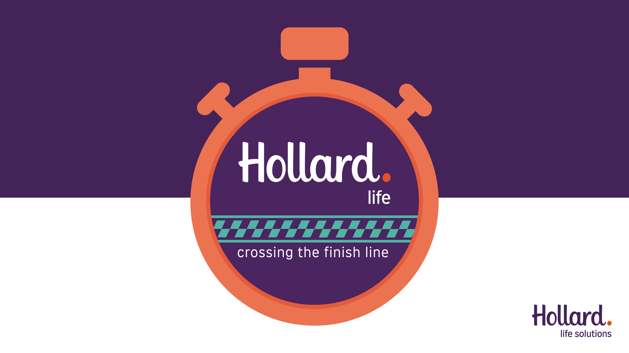
Notes:
Hollard Life, FUL Sales Conference 2026, crossing the finish line.

Slide 2
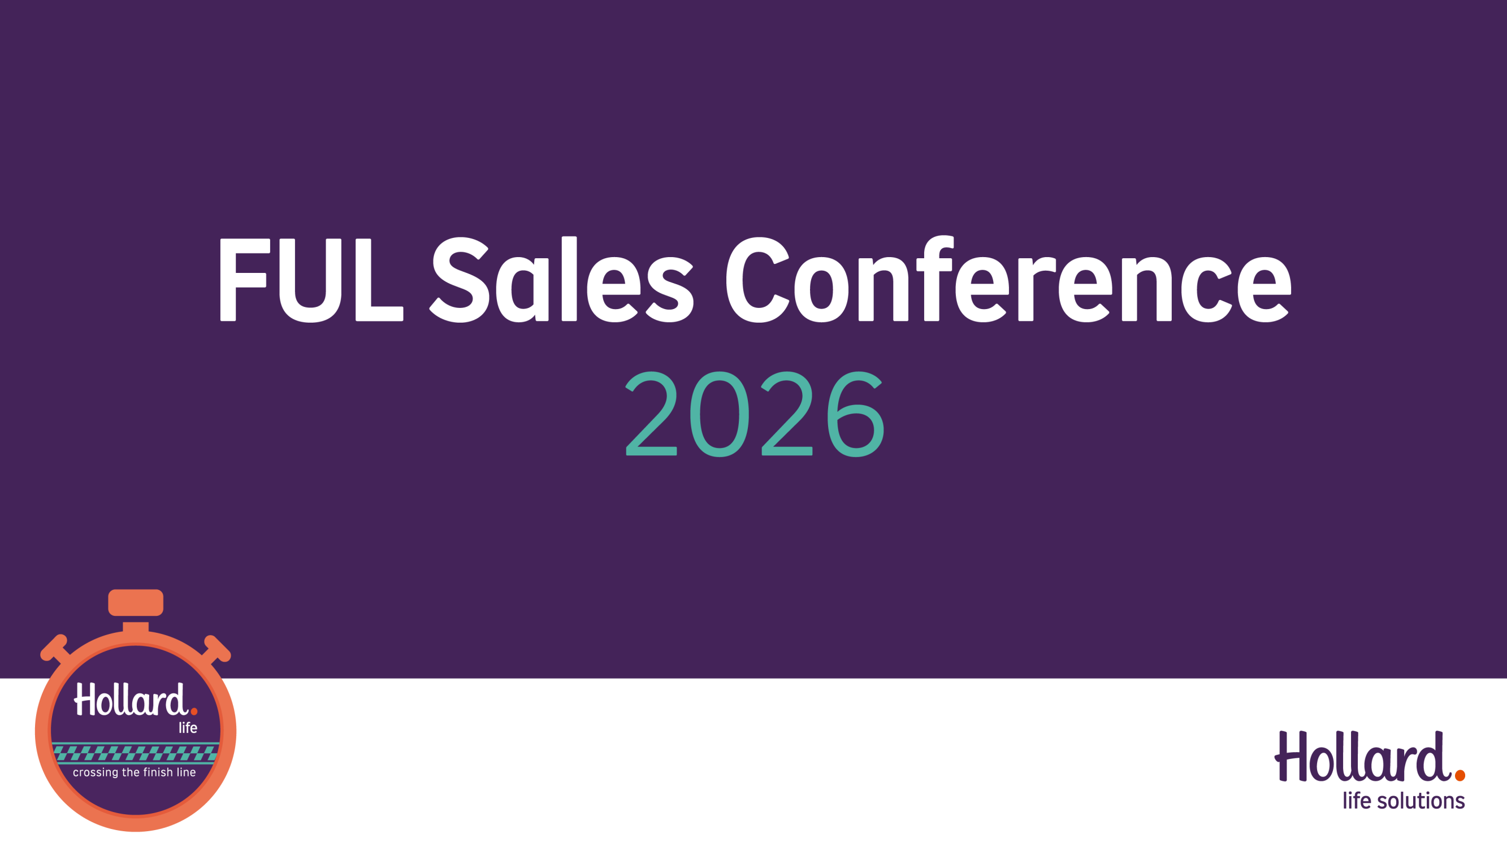
Notes:
FUL Sales Conference 2026.

Slide 3

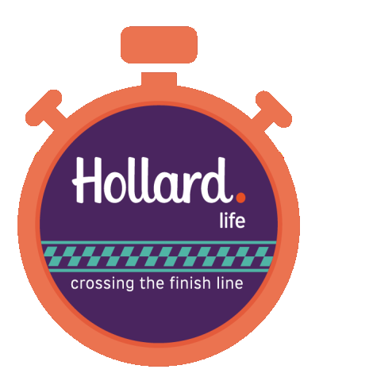

PARTNER INTRODUCTION
Group life cover, quoted to issued in minutes
A digital group life proposition for benefit consultants and the clients they look after.
Notes:
Partner introduction. Simply offers group life cover that can be quoted to issued in minutes, a digital proposition built for benefit consultants and the clients they look after. Backed by Hollard.

Slide 4

WHO IS SIMPLY
A digital-first life insurer, built in South Africa
Simply is a provider of digital life insurance products.
OUR UNDERWRITER
Founded in 2015 by Anthony Miller and Simon Nicholson.
Backed by Hollard
Our goal is to secure the financial futures of millions of South Africans, and core to that goal is accessing customers via their employers.
Every Simply policy is underwritten by Hollard Life Assurance Company, one of South Africa's largest privately owned insurers.
Notes:
Simply is a digital-first life insurer built in South Africa, founded in 2015 by Anthony Miller and Simon Nicholson. The goal is to secure the financial futures of millions of South Africans, largely by reaching them through their employers. Every policy is underwritten by Hollard.

Slide 5
WHAT WE OFFER
A cover range built around the workplace
YOUR FOCUS
Flexi Staff Cover
Flexi Family Cover
Flexi Domestic Cover
Group life cover offering a flexible combination of life, lump sum disability, critical illness, temporary income protection and funeral cover.
Life, disability and funeral cover, mix-and-match for individuals and families.
Cover for a domestic worker, funded by the employer.
Includes an Employee Assistance Programme at no extra cost.
Notes:
Simply's product range. Flexi Staff Cover is your focus: flexible group life, lump sum disability, critical illness, temporary income protection and funeral cover, with an Employee Assistance Programme included at no extra cost. Alongside it sit Flexi Family Cover and Flexi Domestic Cover.

Slide 6
WHAT MAKES US SPECIAL
Quote to inception, fully online
One unbroken digital journey, for schemes of up to 400 employees.
01
02
03
04
Initial estimate
Full quote
Inception
Employee onboarding
A ballpark in seconds using average scheme data.
With the employee data, move straight to a guaranteed quote co-designed with the client.
Digital onboarding, with data integrations streamlining the process where possible.
A digital process post-sale to communicate to employees and gather required information.
Notes:
What makes us special: quote to inception is one unbroken digital journey for schemes of up to 400 employees. Step one, an initial estimate in seconds. Step two, a full guaranteed quote co-designed with the client if you have the data. Step three, digital inception with data integrations. Step four, employee onboarding post-sale.

Slide 7
WHAT MAKES US SPECIAL
More of what makes us special
Flexible benefits, configured live
No medical underwriting
Change the benefit design in the meeting and see the premium move in real time, in front of your client.
Above the free cover limit, just simple health questions. No blood tests or medicals. Accidental cover above the limit for those with underlying health issues.
Minimum group premium from R299pm
Payroll integration, end to end
Employee engagement post-sale
Pull employee data from payroll to quote, incept and manage the policy. Joiners, leavers and salary changes sync on their own.
After the sale we engage employees directly to gather beneficiaries and complete any underwriting above the FCL.
Notes:
More of what makes us special: flexible benefits configured live, with premiums moving in real time and a minimum group premium of just R299 per month. No medical underwriting above the free cover limit, just simple health questions. Payroll integration end to end, with joiners, leavers and salary changes syncing automatically. And employee engagement after the sale to gather beneficiaries and complete underwriting above the FCL.

Slide 8
WHAT ARE OUR LIMITATIONS
Our standard product currently has some limitations
COMING
No PHI benefit
No benefits for parents or extended family, or flexible top ups to employee benefits.
Temporary Income Protection and Occupational Disability as substitutes.
On the roadmap, with voluntary cover by the end of the year.
Lump sum cover capped at R2.5m*
Fairly rigid pricing and product rules*
A result of simplified underwriting. Still works for a high proportion of South African clients.
A straight-through process means fixed rules around pricing and features such as free cover limits.
* We have recently launched a 'manual' version that can flex pricing, limits and rules for large or bespoke requirements.
Notes:
Being honest about limitations. Our standard product has no PHI benefit today, with temporary income protection and occupational disability as substitutes, and no cover for parents, extended family or flexible top-ups, though voluntary cover is on the roadmap by year end. Lump sum cover is capped at R2.5m due to simplified underwriting, and pricing and product rules are fairly rigid. Note that we have recently launched a manual version that can flex pricing, limits and rules for large or bespoke requirements.

Slide 9
WHO DO WE WORK BEST FOR
Where Simply fits best
Tech solves a real problem
Smaller schemes
Larger, low-benefit schemes
Most effective where our technology removes friction for both the business owner and the consultant.
Quick and easy to onboard and manage, close a deal in one meeting.
Larger companies with mostly lower earners and/or low benefit levels, or high staff turnover.
Changes the economics of servicing smaller customers.
Technology greatly reduces the burden of onboarding and managing the policy.
Opens up new segments and opportunities to grow your customer base.
Shifts the effort versus reward equation relative to other insurers.
“
We don't want to be another provider on your panel that you're adding to a selection of quotes.
We want to be a preferred Partner where our solution makes the most sense for you and your client.
Notes:
Where Simply fits best: our technology is most effective where it removes friction for both the business owner and the consultant. Smaller schemes are quick to onboard and manage, letting you close in one meeting and changing the economics of servicing smaller customers. Larger, low-benefit schemes with high staff turnover also benefit hugely because technology cuts the burden of onboarding and management. We don't want to be another quote on your panel, we want to be a preferred partner.

Slide 10
THE PARTNERSHIP
A distribution partnership built to reward you
Simply Financial Services, underwritten by Hollard. Here is how consultant remuneration works.
Notes:
Now to the partnership itself, and specifically how you earn. This is the Simply and Hollard distribution partnership, Simply Financial Services underwritten by Hollard.

Slide 11
CONSULTANT REMUNERATION
Group Life, the core product
50% of regulated broker commission , paid as premiums are collected. In some cases it may be upfronted and paid annually, with clawback.
WORKED EXAMPLE
A new group policy with a monthly premium of R10,000 . The broker consultant can earn:
MONTHLY PREMIUM
MAX COMM.
First R16,666.67
7.5%
Next R8,333.33
5.0%
R375/ month
Next R25,000.00
3.0%
For as long as the policy stays active, growing as the premium increases.
Next R116,666.67
2.0%
Above R166,666.67
1.0%
R3,750upfront
For new schemes, an additional 90% of the first month's premium , up to a maximum of R7,500, subject to clawback in the first year.
90% of the first month's premium, subject to first-year clawback.
Notes:
Consultant remuneration on the core Group Life product. You earn 50% of the regulated broker commission, paid as premiums are collected, and in some cases upfronted and paid annually with clawback. For new schemes there is an additional 90% of the first month's premium, capped at R7,500 and subject to first-year clawback. The commission scale is tiered by monthly premium, as shown. Worked example: on a new R10,000 per month group policy, the consultant earns R375 per month for as long as the policy stays active, growing as the premium grows, plus R3,750 upfront.

Slide 12
CONSULTANT REMUNERATION
Group Life, group funeral
Commission for funeral-only group business (Cat A) is not capped , and can be flexed up to 25% of the monthly premium .
IMPORTANT
For these sales specifically, consultant remuneration will not be 50% of actual broker commission. It will be 50% of the theoretical Group Life scales from the previous slide.
The premium payable is loaded for whatever level of commission is selected.
This may be revised in future, but any change would need a direct flow-through to the premium payable.
Notes:
Group Life, group funeral. Commission for funeral-only group business, category A, is not capped and can be flexed up to 25% of the monthly premium. The premium payable is loaded for whatever level of commission is selected. Important: for these sales specifically, consultant remuneration will not be 50% of the actual broker commission. It will be 50% of the theoretical Group Life scales from the previous slide. This may be revised in future, but any change would need a direct flow-through to the premium payable.

Slide 13
CONSULTANT REMUNERATION
Retail life
Not promoted, but available on demand.
25%
Debit order business
Paid as and when premiums are collected.
of broker commission
Stop order business
Commission set at the statutory maximum, subject to clawback. Structure and timing follow the terms agreed per broker.
Paid upfront, with some retention.
All subject to discussion during broker contracting.
Notes:
Retail life. This is not promoted, but it is available on demand. Consultants earn 25% of broker commission. Structure and timing follow the terms agreed per broker, with commission set at the statutory maximum, subject to clawback. Typical structures: debit order business is paid as and when premiums are collected; stop order business is paid upfront with some retention. All of this is subject to discussion during broker contracting.

Slide 14
THE POSSIBLE BENEFIT
What this can add up to
R20,000/ month
R2,000/ month
New group premium
Retail new business
Four policies of R5k each, three new schemes and one replacement.
Four funeral plans and one simplified-issue life plan.
~R25,000/ month
in extra income within one year, of which R9k is recurring.
No minimum production thresholds, start earning from rand one of production.
Notes:
What this can add up to. Say a consultant writes R20,000 per month of new group premium, four policies of R5,000 each, three new schemes and one replacement. And they supplement that with another R2,000 per month of retail new business, four funeral plans and one simplified-issue life plan. Within one year they could be earning close to R25,000 per month in extra income, of which R9,000 is recurring. There are no minimum production thresholds, you start earning from rand one of production.

Slide 15
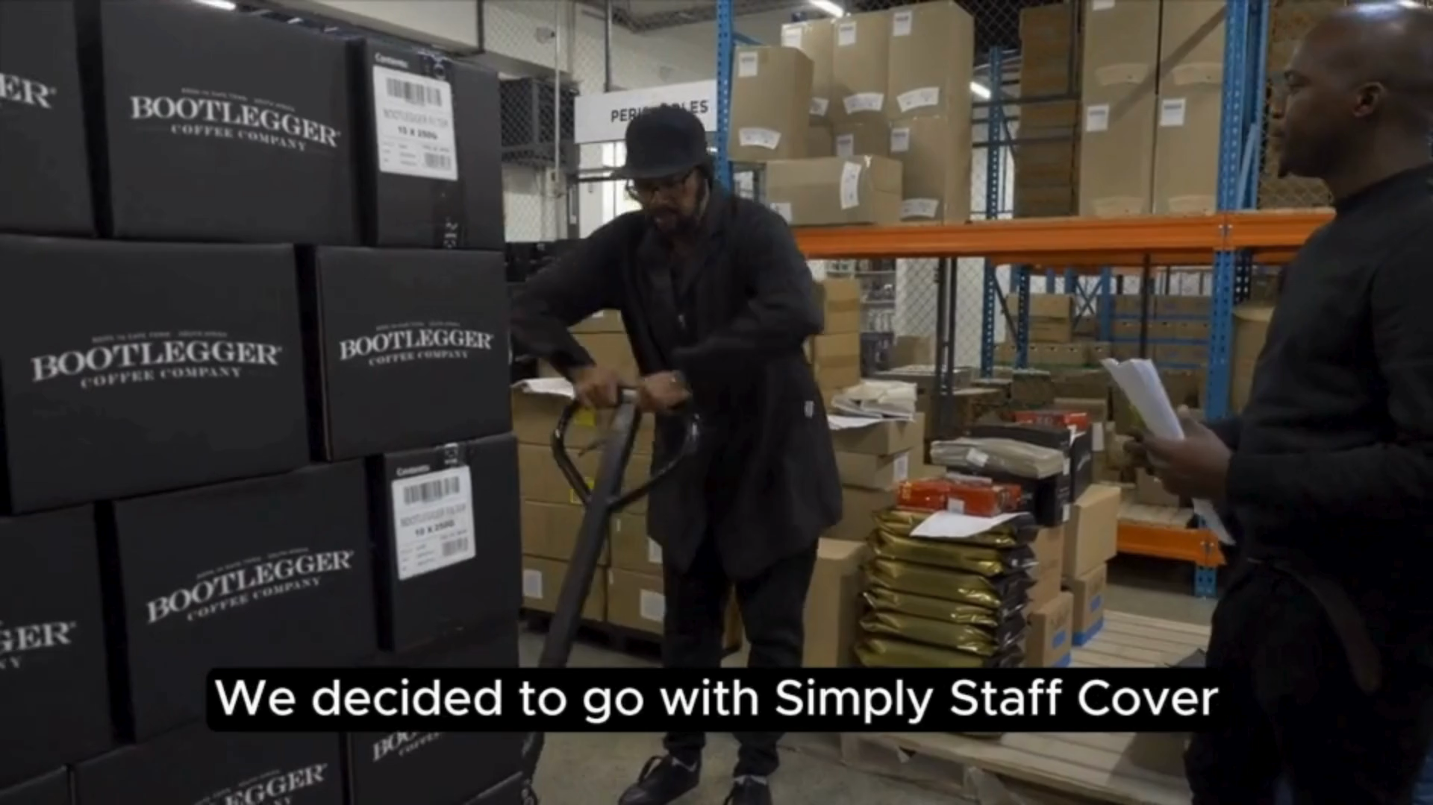
THE PARTNERSHIP
Sales demo
Let's see how it all comes together, live.
simply.co.za
Notes:
To close, let's move to a live sales demo. Everything you have seen comes together at simply.co.za.

Slide 16

WHERE TO FROM HERE
Next steps
1
Share the link for Hollard Life Solutions (HLS) BC accreditation .
2
Build familiarity with the Simply preprod environment.
3
Commission calculator for HLS BCs.
4
Regular Q&A sessions for BCs and recruited IFAs.
Aug 2026
Official launch. Welcome packs sent to newly onboarded brokerages.

